Slide 1

Facial Recognition Project
Jacqueline Tang
How machine learning can bridge emotional gaps

Slide 2
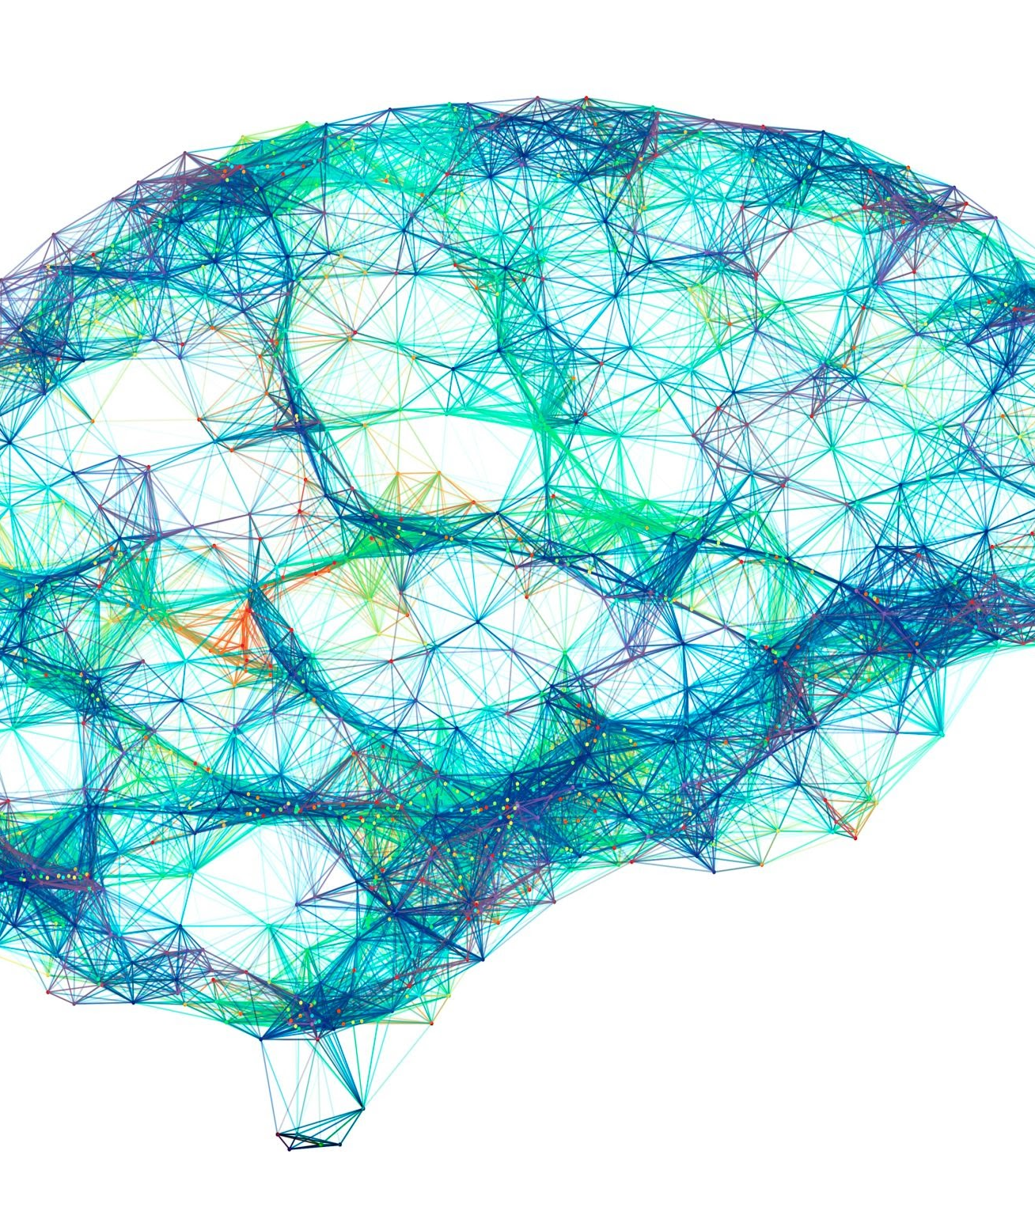
What is this trying to accomplish?
Help out those with alexithymia (emotional blindness), especially neurodivergent people (non-medical term encompassing a wide variety of mental disorders), to express and communicate emotions
Can deep-learning be used as a solution? Will neurodivergent people have a better chance at expressing their emotions? Can those emotions be handled better?
Can caretakers use this technology to help these people?

Slide 3
How can we use a model trained from scratch to help neurodivergent people express their emotions using facial recognition technology?

Slide 4

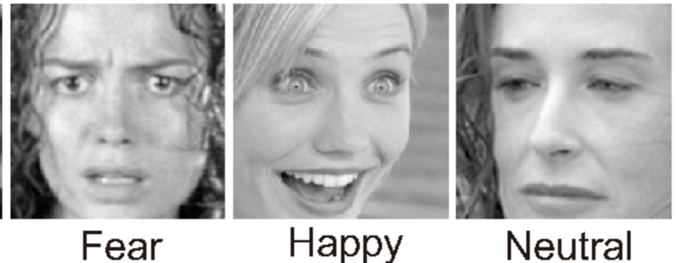
Test various pretrained models that have been fine-tuned along with a model trained from scratch towards facial emotion recognition by training on labeled dataset.
Goal: Classify facial images with 8 classes based on expressed emotion.
Kaggle Dataset used: FER2013 (Predetermined training/testing sets)
80/20 Training/Validation split. Testing dataset provided separately.
Solution/Approach

Slide 5
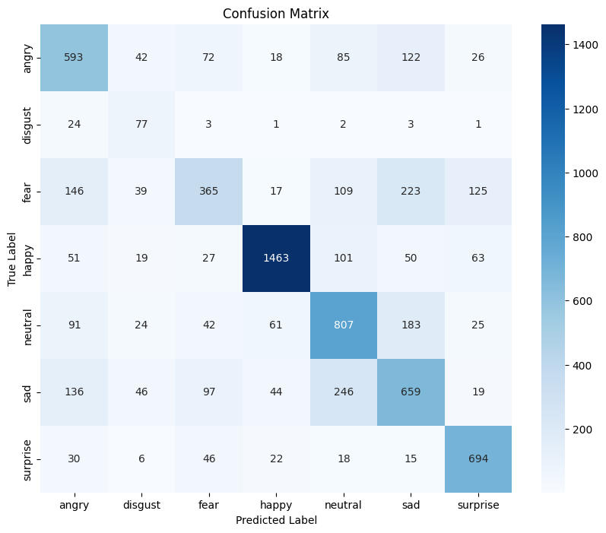
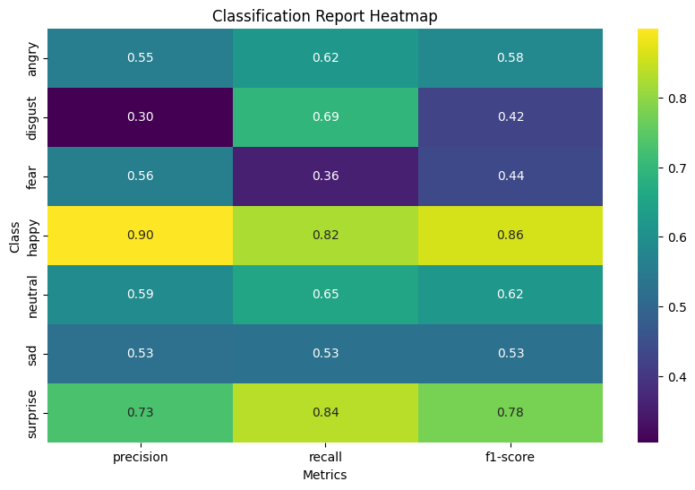
Total Test Accuracy: 68.18%
‘Happy’ in FER2013 had 1774 images but ‘Disgust’ had 111, result of class imbalance.
‘Fear’ with high Precision but low Recall →
Model misses many true “Fear” labels.
‘Disgust’ with high Recall but low Precision → Model tends to incorrectly label other labels as ‘disgust’.
Best scoring class → ‘Happy’
Results

Slide 6


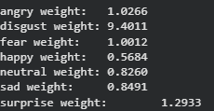
Problems and Limitations.
Class Labels:
Labels don’t necessarily pass the eye test. Overlap between different labels could significantly hamper training.
Model will struggle with emotions that have less distinguishing features.
Class Imbalance:
Training dataset heavily imbalanced. 436 “Disgust” samples vs. 4097 “Fear” samples.
Result → Weak discriminating ability between “Disgust” and other labels.
Addressed issue by weighting samples based on labels.
True Label: “Angry”
True Label: “Disgust”
Can you tell the difference?
Each class’s weight
This could be a bottleneck in our model’s performances!

Slide 7
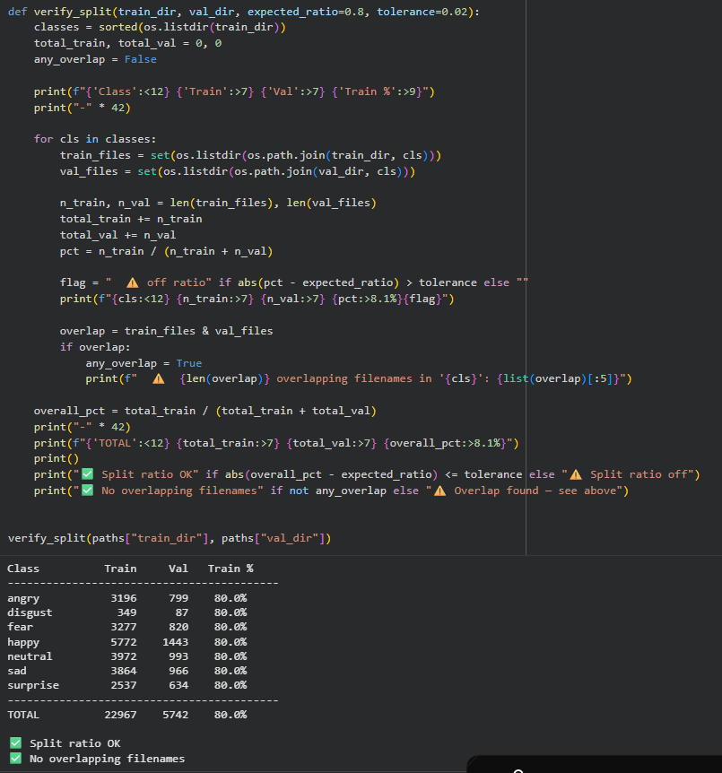
Workflow
Data Preprocessing (01_prepare_data.ipynb):
  Training Data: We perform a 80-20 Stratified Split across all classes for a training and validation dataset. Test data is provided by the FER2013 Dataset.
  Saves a single, unified set of split data in our drive that is used for all model training.
Model Training (02_train_model.ipynb):
  Trains one pre-trained model and saves the model weights + train history with early stopping. (Ran multiple times across all models)
  Hyperparameters:
    Batch Size: 64, Epochs: 30, Learning Rate: 1e-4, Optimizer: Adam, Loss Function: Cross Entropy, Early Stopping Threshold: 7 epochs.
Model Evaluation (03_evaluate.ipynb):
  Tests all saved model weights against the test dataset provided by FER2013

Slide 8
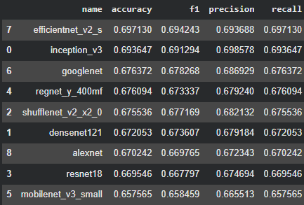
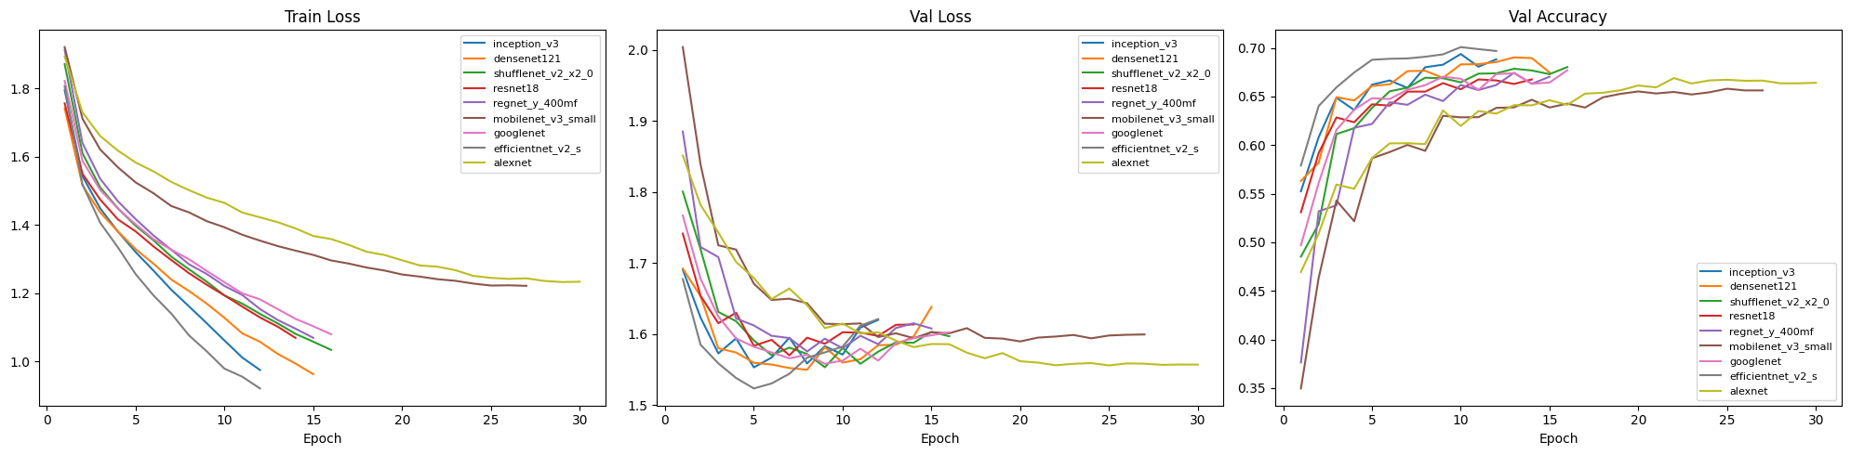
Results Analysis Pt. 1
Most models converge before 30 epochs: Most Val Loss/Accuracy plateaus at around 15 epochs, as showing by the early stopping in the training history visualizations.
Best Performing Model: EfficientNet V2 across all metrics: (accuracy, f1, precision, recall)
  Across all models, no significant difference between accuracy, f1, precision, recall.
Worst Performing Model: Mobilenet_v3_small performed the worst, having an accuracy of 0.658, still indicating strong performance.

Slide 9
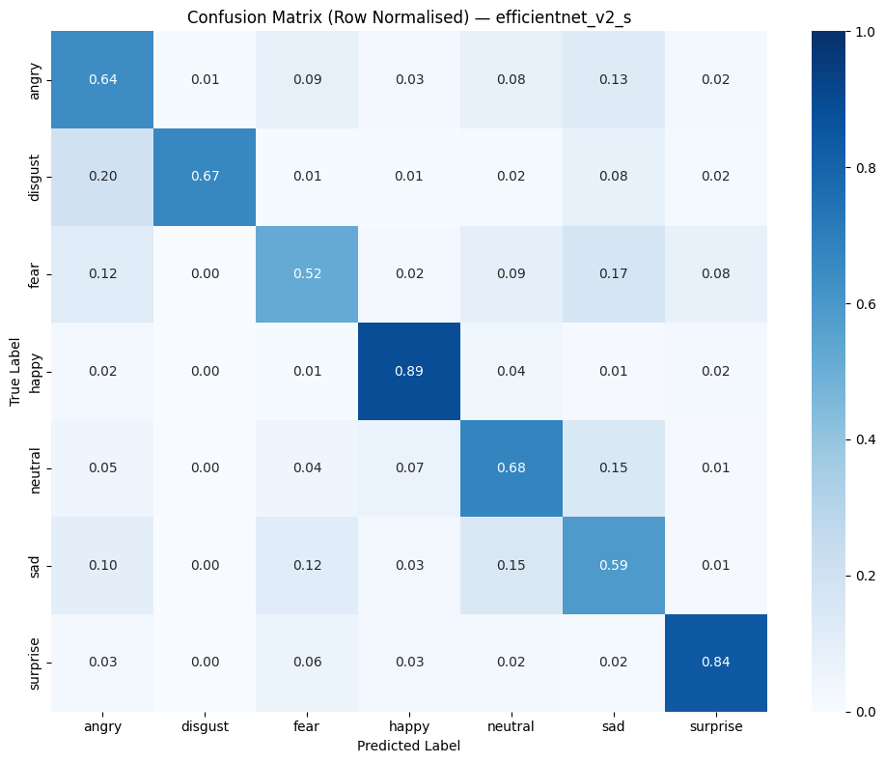
Results Analysis Pt. 2
Generalized Class Performance:
  Happy and Surprise were most correctly labeled by all models: 0.90, 0.83 by efficient net respectively.
  Most models failed to correctly label Fear, (0.51 by efficient net)
While EfficientNet V2 had the best test performance overall, it did not score the highest amongst every class/emotion.
  Worse-performing models such as MobileNet V3 (.658 accuracy) and ShuffleNet V2 (.676 accuracy) outscored EfficientNet on Disgust (0.77, 0.71 vs. 0.62) and others.
  → Cannot concretely say EfficientNet is the best model to use! Dependent on both test dataset (skewed towards happy and fear) as well as use case (which emotions should we prioritize, if not all of them equally?

Slide 10
Takeaways
Model accuracies are all in the 65-70% accuracy range.
A reason for this performance may be due to bottlenecks inherent to the dataset we used:
May need a dataset with a high amount of images to train on for certain emotions (especially ‘Disgust,’ ‘Surprise,’ ‘Angry’)
Dangers of privacy concerns since the model stores biological information (e.g. selling that information) due to real faces being fed into the algorithm, certain groups such as corporations and governments should not get a hold

Slide 11
Any questions?
GitHub repository of the code linked here: https://github.com/jt187276/FER2013-Facial-Recognition

